Slide 1
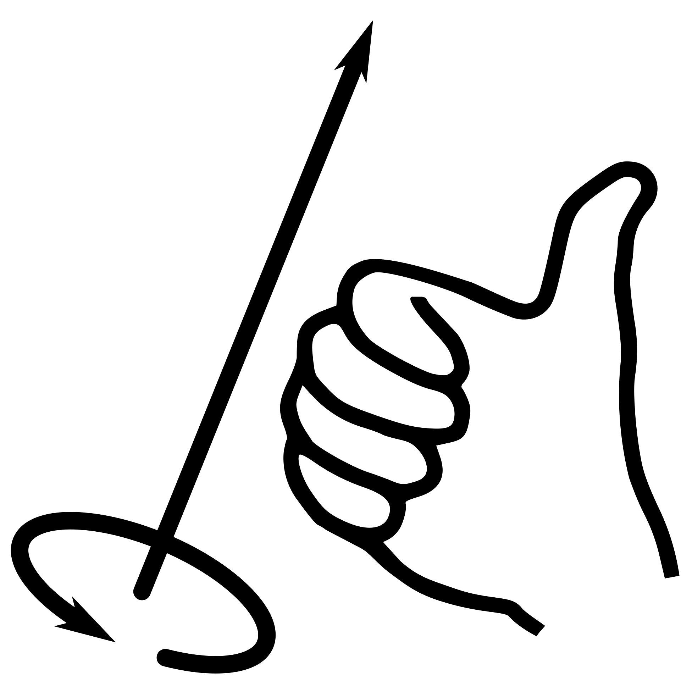
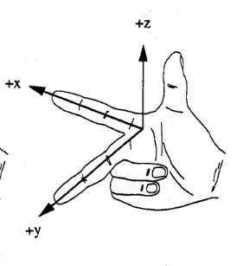
+z
+X
Right hand axis with right hand rule for rotations
+Y

